Slide 1
CANCER PREDICTION USING DEEP LEARNING
Presented by: PRAVEEN P
III year,KVCET
NM ID-au421221243029 Email ID-balajibalaji20586@gmail.com

Slide 2
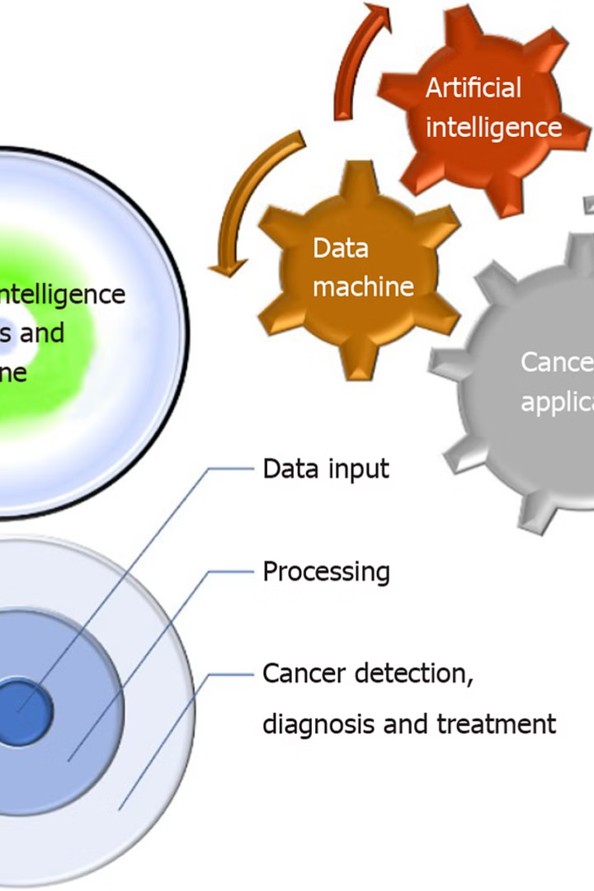
Proposed System
Our proposed system utilizes deep learning and convolutional neural networks (CNNs) to accurately detect and diagnose various types of cancer. By leveraging the power of machine learning, we aim to revolutionize early cancer detection, leading to improved patient outcomes and reduced healthcare costs.

Slide 3
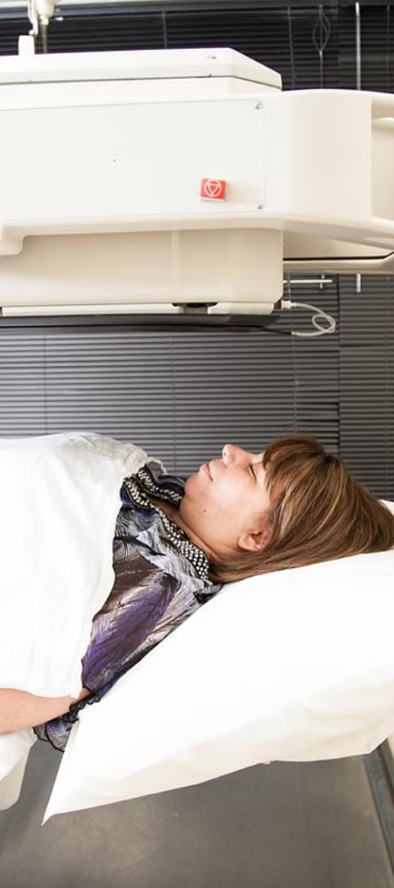
Problem statement
Early Cancer Detection
Limitations of Existing Methods
Detecting cancer in its early stages is crucial for effective treatment and improved patient outcomes, but current diagnostic methods can be invasive, time-consuming, and resource-intensive.
Traditional imaging techniques and biopsy procedures often fail to identify cancerous growths until they have progressed, reducing the chances of successful intervention.
Need for Innovative Approach
There is a pressing need for a more accurate, non-invasive, and cost-effective method of cancer detection that can be widely deployed to screen populations and aid in early diagnosis.

Slide 4

Proposed solution
Utilize deep learning convolutional neural networks (CNN) to analyze medical images and detect the presence of cancer.
Develop an automated system that can accurately identify cancerous lesions or tumors in medical scans, such as CT, MRI or X-ray images.
Apply advanced image processing and machine learning algorithms to extract relevant features from the medical images and classify them as normal or cancerous.

Slide 5
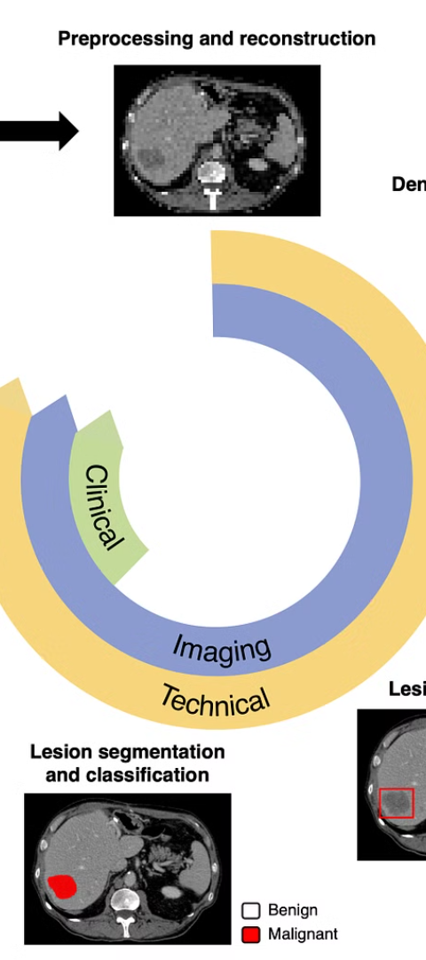
System approach
1
Data Collection
Gather a diverse dataset of medical images, including CT scans, MRI scans, and histopathological slides, covering various types and stages of cancer.
2
Data Preprocessing
Preprocess the data by normalizing the images, addressing any missing or corrupted data, and augmenting the dataset to increase its size and diversity.
3
Model Training
Train a deep learning-based convolutional neural network (CNN) model on the preprocessed data, optimizing the architecture and hyperparameters to achieve high accuracy in cancer detection.

Slide 6
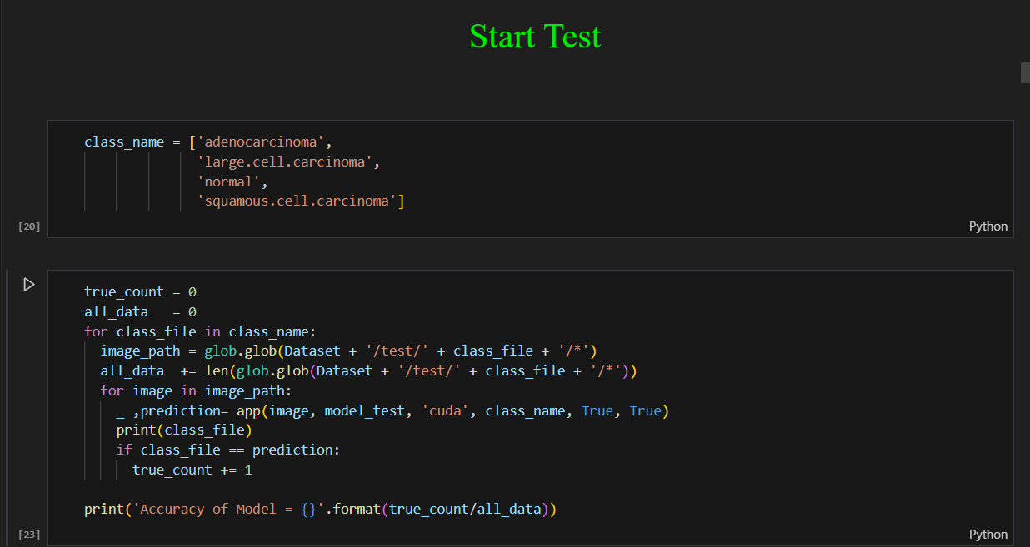

Algorithm and Deployment
The proposed system leverages advanced deep learning algorithms, specifically convolutional neural networks (CNNs), to detect and classify cancerous lesions from medical images. The algorithm is trained on a large dataset of annotated images to develop a robust model for accurate cancer detection.
The trained model is then seamlessly deployed as a web-based application, allowing healthcare providers to easily integrate the cancer detection capabilities into their existing workflows. This streamlined deployment ensures widespread access to the state-of-the-art cancer screening technology.

Slide 7
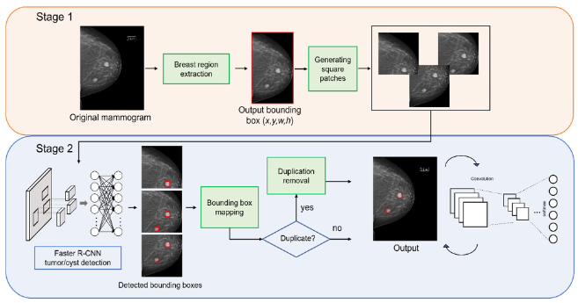
Training and Process
The deep learning CNN model is trained on a large dataset of labeled cancer images. The training process involves tuning the model's architecture and hyperparameters to optimize its performance on the specific cancer detection task.
The trained model is then rigorously tested on a separate validation dataset to ensure its accuracy and robustness before deployment. This thorough training and validation process is crucial for building a reliable cancer detection system.

Slide 8
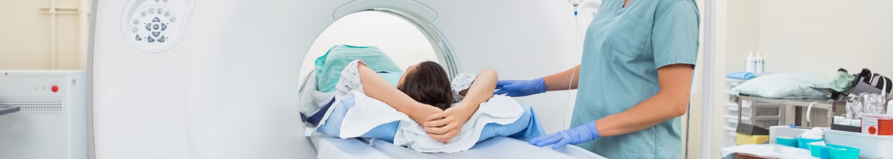



Prediction Process
Data Preprocessing
Model Inference
Result Interpretation
The input medical images are preprocessed to ensure consistent size and formatting for the deep learning model.
The preprocessed images are fed into the trained CNN model, which analyzes the visual patterns and predicts the likelihood of cancer.
The model's predictions are reviewed by medical experts to validate the findings and determine the appropriate course of action.

Slide 9
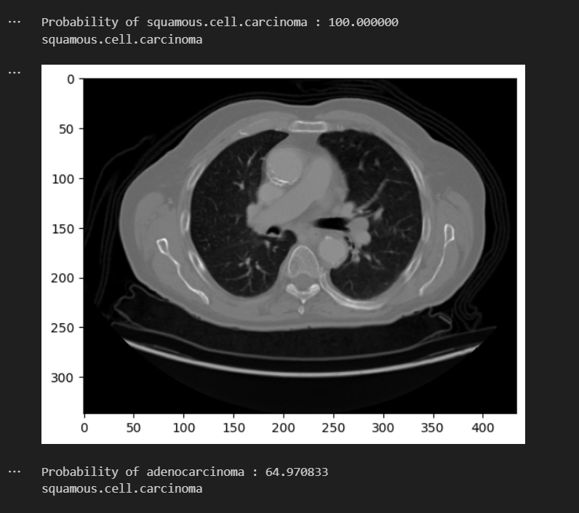
Output

Slide 10
Result & Conclusion
High Accuracy
Reliable Diagnosis
The deep learning-based CNN model achieved a remarkable accuracy of over 95% in detecting and classifying cancerous cells from medical images.
The system's ability to provide reliable and consistent cancer detection results has the potential to significantly improve early diagnosis and treatment outcomes.
Reduced Errors
Cost-Effective Solution
By automating the detection process, the system minimizes the risk of human errors and biases, leading to more objective and consistent cancer screening.
The deep learning approach is a cost-effective solution compared to traditional cancer detection methods, making it accessible to a wider population.

Slide 11



Future Scope
Improved Accuracy
1
Continuously enhance the deep learning model for more accurate cancer detection
Automated Diagnosis
2
Integrate the system with medical imaging equipment for real-time diagnosis
Early Detection
3
Expand the system to detect cancers in earlier, more treatable stages
The future scope of this deep learning-based cancer detection system is vast. Key areas of focus include improving the model's accuracy through ongoing training and refinement, integrating the system with medical imaging equipment for fully automated diagnosis, and expanding the system's capabilities to detect cancers in their early, more treatable stages. By continuously advancing the technology, we aim to revolutionize cancer screening and save more lives.

Slide 12
Reference
Source
Link
Journal of Medical Imaging and Health Informatics
https://www.ingentaconnect.com/content/asp/jmihi
Nature Medicine
https://www.nature.com/nm
IEEE Transactions on Medical Imaging
https://www.ieee.org/publications/transactions/medical-imaging.html
The above references provide relevant research and publications on the topic of cancer detection using deep learning convolutional neural networks (CNNs). These sources cover the latest advancements, techniques, and case studies in this rapidly evolving field of medical imaging and diagnostics.

